Slide 1
VEHICLE SERVICE

Slide 2

Milestone service center
ADMIN
LOG IN
FRONT OFFICE
LOG IN
WORKERS
LOG IN

Slide 3
FRONT OFFICE
User name
Password
BACK
LOG IN

Slide 4
ADMIN
User name
Password
BACK
LOG IN

Slide 5
WORKERS
User name
Password
BACK
LOG IN

Slide 6

customer DETAILS
Staff department
VEHICLE DETAILS
Sale
Work status
gallery
Free service
Paid service
Repair
Performance tuning
LIST
LIST
LIST
LIST
LOG OUT

Slide 7
NEW
OPEN
SAVE
DELETE
RELOAD
PRINT
CLOSE
LIST
WORK STATUS
Free service
Paid service
Repair
Performance tuning
Customer details
New customer
KMs/time: 12000
Service Count: 5
Name: customer1
Address: place
Contact no.: 123
License number: 321
Suggestions
No.
01
Clutch problem
Vehicle details
New vehicle
Number plate: KL 46 R 258
Make: RE
Model: Classic 350
Year: 2017
Color: black
Fuel type: P
Gear type: M
Engine no: 43323
Warranty expiry: 2019
Insurance details:
No.
payment services/part description
Amount
01
Oil change
DISCOUNTS:
TOTAL:

Slide 8
NEW
OPEN
SAVE
DELETE
RELOAD
PRINT
CLOSE
LIST
WORK STATUS
Free service
Paid service
Repair
Performance tuning
Customer details
New customer
KMs/time:
Service Count:
Name:
Address:
Mobile number:
License number:
No.
Suggestions
Vehicle details
New vehicle
Number plate:
Make:
Model:
Year:
Color:
Fuel type:
Gear type:
Engine no:
Warranty expiry:
Insurance details:
No.
payment services/part description
Amount
DISCOUNTS:
TOTAL:

Slide 9
NEW
OPEN
SAVE
DELETE
RELOAD
PRINT
CLOSE
LIST
WORK STATUS
Free service
Paid service
Repair
Performance tuning
Customer details
New customer
No.
Suggestions
Name: customer2
Address: place
Mobile number: 2323
License number: 3423
1
Over heating
New vehicle
Vehicle details
Number plate: KL46-2367
Make: Suzuki
Model: wagon R
Year: 2012
Color: white
Fuel type: P
Gear type: M
Engine no:
Warranty expiry:
Insurance details:
KMs:
No.
payment services/part description
Amount
DISCOUNTS:
TOTAL:

Slide 10
NEW
OPEN
SAVE
DELETE
RELOAD
PRINT
CLOSE
LIST
WORK STATUS
Free service
Paid service
Repair
Performance tuning
Customer details
New customer
No.
Suggestions
Name:
Address:
Mobile number:
License number:
New vehicle
Vehicle details
Number plate:
Make:
Model:
Year:
Color:
Fuel type:
Gear type:
Engine no:
Warranty expiry:
Insurance details:
KMs:
No.
payment services/part description
Amount
DISCOUNTS:
TOTAL:

Slide 11
FREE SERVICE
No
Customer name
Contact no.
vehicle
year
suggestions
Part description
priority
CUSTOMER1
123
Classic 350
2017
Clutch problem
Oil change
100
CUSTOMER2
CUSTOMER3
BACK
MAIN MENU

Slide 12
PAID SERVICE
No
Customer name
Contact no.
vehicle
year
suggestions
Part description
priority
CUSTOMER1
CUSTOMER2
CUSTOMER3
BACK
MAIN MENU

Slide 13
REPAIR
No
Customer name
Contact no.
vehicle
year
suggestions
Part description
priority
CUSTOMER1
overheating
2323
Wagon R
2012
CUSTOMER2
CUSTOMER3
BACK
MAIN MENU

Slide 14
PERFOMANCE TUNING
No
Customer name
Contact no.
vehicle
year
suggestions
Part description
priority
CUSTOMER1
CUSTOMER2
CUSTOMER3
BACK
MAIN MENU

Slide 15
ASSIGN WORKER
WASHING | PAINTING | TYRE & ALIGNMENT | BODY REPAIR | ENGINE REPAIR
WORKER1 | WORKER1 | WORKER1 | WORKER1 | WORKER1
WORKER2 | WORKER2 | WORKER2 | WORKER2 | WORKER2
WORKER3 | WORKER3 | WORKER3 | WORKER3 | WORKER3
WORKER4 | WORKER4 | WORKER4 | WORKER4 | WORKER4
OK

Slide 16
ASSIGN WORKER
WASHING | PAINTING | TYRE & ALIGNMENT | BODY REPAIR | ENGINE REPAIR
WORKER1 | WORKER1 | WORKER1 | WORKER1 | WORKER1
WORKER2 | WORKER2 | WORKER2 | WORKER2 | WORKER2
WORKER3 | WORKER3 | WORKER3 | WORKER3 | WORKER3
WORKER4 | WORKER4 | WORKER4 | WORKER4 | WORKER4
OK

Slide 17
ASSIGN WORKER
WASHING | PAINTING | TYRE & ALIGNMENT | BODY REPAIR | ENGINE REPAIR
WORKER1 | WORKER1 | WORKER1 | WORKER1 | WORKER1
WORKER2 | WORKER2 | WORKER2 | WORKER2 | WORKER2
WORKER3 | WORKER3 | WORKER3 | WORKER3 | WORKER3
WORKER4 | WORKER4 | WORKER4 | WORKER4 | WORKER4
OK

Slide 18
ASSIGN WORKER
WASHING | PAINTING | TYRE & ALIGNMENT | BODY REPAIR | ENGINE REPAIR
WORKER1
WORKER1
WORKER1
WORKER1
WORKER1
WORKER2
WORKER2
WORKER2
WORKER2
WORKER2
WORKER3
WORKER3
WORKER3
WORKER3
WORKER3
WORKER4
WORKER4
WORKER4
WORKER4
WORKER4
OK

Slide 19
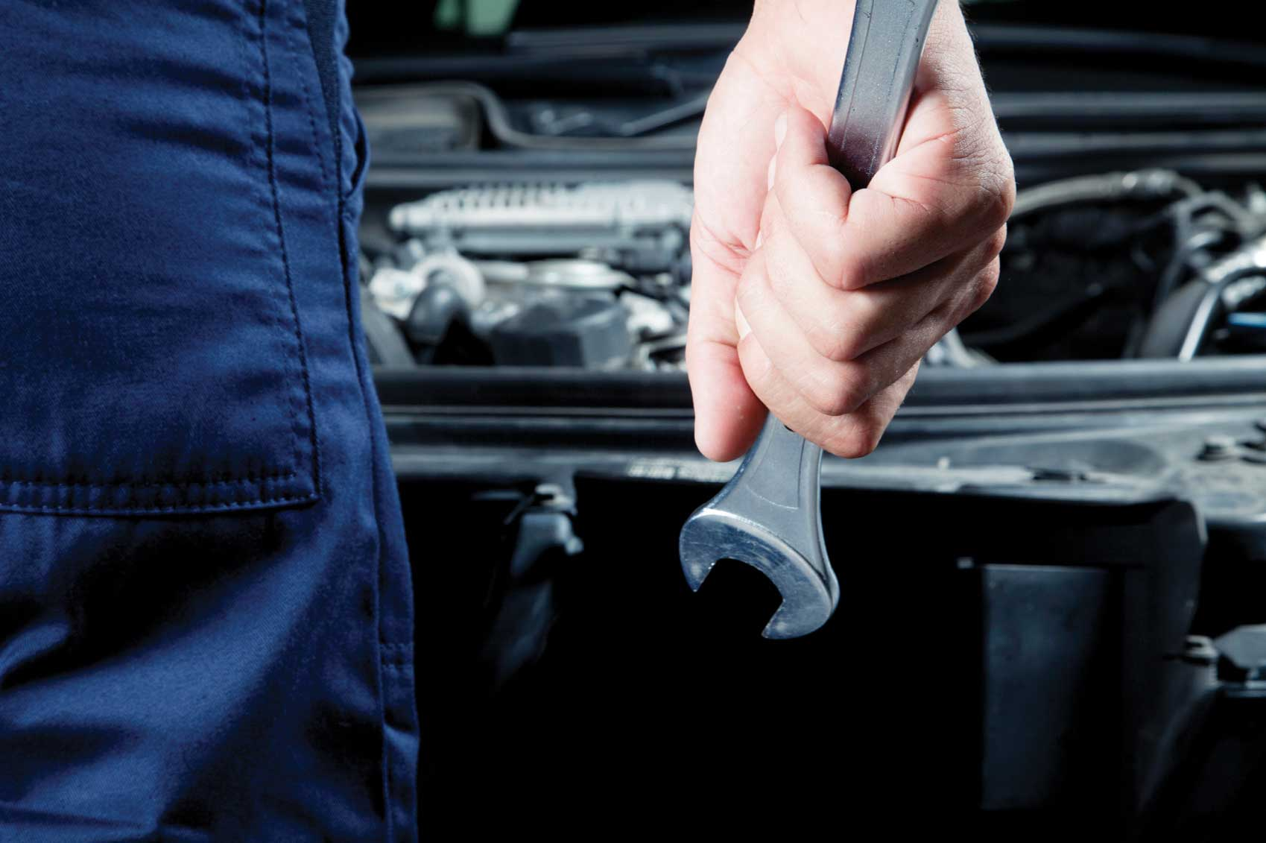
MILESTONE SERVICE CENTER
MESSAGES
NEW TASKS
STOCK DETAILS
PENDING TASKS
MONTHLY REPORT
WORK HISTORY
LEAVE ENTRY
LOG OUT

Slide 20
TASKS
CUSTOMER NAME | CONTACT NO. | NUMBER PLATE | YEAR | SUGGESTIONS | PART DESCRIPTION | PRIORITY | MORE
CUSTOMER1 | 123 | KL46 R 258 | 2017 | clutch problem | oil change | 100 |  | START
 |  |  |  |  |  |  |  | START
 |  |  |  |  |  |  |  | START
 |  |  |  |  |  |  |  | START
 |  |  |  |  |  |  |  | START
 |  |  |  |  |  |  |  | START
 |  |  |  |  |  |  |  | START
 |  |  |  |  |  |  |  | START
 |  |  |  |  |  |  |  | START
BACK

Slide 21
PENDINg TASKS
CUSTOMER NAME | CONTACT NO. | NUMBER PLATE | YEAR | SUGGESTIONS | PART DESCRIPTION | PRIORITY | MORE
CUSTOMER1 | 123 | KL46 R 258 | 2017 | clutch problem | oil change | 100 |  | START
 |  |  |  |  |  |  |  | START
 |  |  |  |  |  |  |  | START
 |  |  |  |  |  |  |  | START
 |  |  |  |  |  |  |  | START
 |  |  |  |  |  |  |  | START
 |  |  |  |  |  |  |  | START
 |  |  |  |  |  |  |  | START
 |  |  |  |  |  |  |  | START
BACK

Slide 22
Number plate: | KL46 R 258
Make: | RE
Model: | Classic 350
Year: | 2017
Color: | Black
Fuel type: | P
Gear type: | M
Engine no: | 43323
Warranty expiry: | 2019
Insurance details:
KMs: | 12000
Service count: | 5
OK

Slide 23
RE Classic 350
Stock purchase
Close task
Hold task
Report
No | suggestions
No | payment services/part description | Amount
BACK

Slide 24
CUSTOMER DETAILS
NAME | ADDRESS | CONTACT NO. | LICENSE NO. | EMAIL | VEHICLES
CUSTOMER1 | ABCD | 123 | 231
MAIN MENU

Slide 25
VEHICLE DETAILS
Number plate | Make | Model | Year | Color | Fuel type | Gear type | Engine no. | Warranty details | Insurance details | KMs | Time | Service count | customer
KL46 R 258 | RE | Classic 350 | 2017 | black | P | M | 43323 | 2019 |  | 12000 |  | 5
KL46 G 2367 | Suzuki | Wagon R | 2013 | White | P | M | 23345 |  |  | 65000
MAIN MENU

Slide 26
Number plate | Make | Model | Year | Color | Fuel type | Gear type | Engine no. | Warranty details | KMs | Time | Service count
KL46 R 258 | RE | Classic 350 | 2017 | black | P | M | 43323 | 2019 | 12000 |  | 5
KL46 G 2367 | Suzuki | Wagon R | 2013 | White | P | M | 23345 |  | 65000
BACK

Slide 27
NAME | ADDRESS | CONTACT NO. | LICENSE NO. | EMAIL
CUSTOMER1 | ABCD | 123 | 231
BACK

Slide 28
STAFF DEPARTMENT
WASHING
PAINTING
TYRE AND ALIGNMENT
BODY REPAIR
ENGINE REPAIR
OFFICE
MAIN MENU

Slide 29
WASHING STAFF
BACK
NAME | CONTACT NO. | STATUS
WORKER1 | 9946666499 | PRESENT
WORKER2
WORKER3

Slide 30
PAINTING STAFF
BACK
NAME | CONTACT NO. | STATUS
WORKER1 | 9946666499 | PRESENT
WORKER2
WORKER3

Slide 31
TYRE AND ALIGNMENT STAFF
BACK
NAME | CONTACT NO. | STATUS
WORKER1 | 9946666499 | PRESENT
WORKER2
WORKER3

Slide 32
BODY REPAIRING STAFF
BACK
NAME | CONTACT NO. | STATUS
WORKER1 | 9946666499 | PRESENT
WORKER2
WORKER3

Slide 33
ENGINE REPAIRING STAFF
BACK
NAME | CONTACT NO. | STATUS
WORKER1 | 9946666499 | PRESENT
WORKER2
WORKER3

Slide 34





search
MAIN MENU

Slide 35
search
MAIN MENU

Slide 36
search
Back to Task

Slide 37
SEARCH
ITEM NAME | STOCK | PRICE
CASTROL | 15 | 500
MOBIL1 | 20 | 450
VALVOLINE | 25 | 550
BACK

Slide 38
SEARCH
ITEM NAME | STOCK | PRICE
CASTROL | 15 | 500
MOBIL1 | 20 | 450
VALVOLINE | 25 | 550
ADD
ADD
ADD
ADD
BACK

Slide 39
WORK STATUS
NO | CUSTOMER NAME | Contact no. | NUMBER PLATE | TYPE | Washing |  | Painting |  | TYRE & alignment |  | Body repair |  | Engine repair
 |  |  |  |  | WORKER | STATUS | WORKER | STATUS | WORKER | STATUS | WORKER | STATUS | WORKER | STATUS
010 | CUSTOMER1 | 994666499 | KL46-258 | Free service | Worker1 | closed
bill
MAIN MENU

Slide 40
customer DETAILS
Staff department
VEHICLE DETAILS
STOCK DETAILS
Work status
ADD MEMO
LOG OUT

Slide 41
CUSTOMER DETAILS
NAME | ADDRESS | CONTACT NO. | LICENSE NO. | EMAIL | VEHICLES
CUSTOMER1 | ABCD | 123 | 231
MAIN MENU

Slide 42
Number plate | Make | Model | Year | Color | Fuel type | Gear type | Engine no. | Warranty details | KMs | Time | Service count
KL46 R 258 | RE | Classic 350 | 2017 | black | P | M | 43323 | 2019 | 12000 |  | 5
KL46 G 2367 | Suzuki | Wagon R | 2013 | White | P | M | 23345 |  | 65000
BACK

Slide 43
VEHICLE DETAILS
Number plate | Make | Model | Year | Color | Fuel type | Gear type | Engine no. | Warranty details | Insurance details | KMs | Time | Service count | customer
KL46 R 258 | RE | Classic 350 | 2017 | black | P | M | 43323 | 2019 |  | 12000 |  | 5
KL46 G 2367 | Suzuki | Wagon R | 2013 | White | P | M | 23345 |  |  | 65000
MAIN MENU

Slide 44
NAME | ADDRESS | CONTACT NO. | LICENSE NO. | EMAIL
CUSTOMER1 | ABCD | 123 | 231
BACK

Slide 45
STAFF DEPARTMENT
ADD STAFF
WASHING
PAINTING
TYRE AND ALIGNMENT
BODY REPAIR
ENGINE REPAIR
OFFICE
MAIN MENU

Slide 46
WASHING STAFF
BACK
NAME | CONTACT NO. | STATUS
WORKER1 | 9946666499 | PRESENT
WORKER2
WORKER3

Slide 47
PAINTING STAFF
BACK
NAME | CONTACT NO. | STATUS
WORKER1 | 9946666499 | PRESENT
WORKER2
WORKER3

Slide 48
TYRE AND ALIGNMENT STAFF
BACK
NAME | CONTACT NO. | STATUS
WORKER1 | 9946666499 | PRESENT
WORKER2
WORKER3

Slide 49
BODY REPAIRING STAFF
BACK
NAME | CONTACT NO. | STATUS
WORKER1 | 9946666499 | PRESENT
WORKER2
WORKER3

Slide 50
ENGINE REPAIRING STAFF
BACK
NAME | CONTACT NO. | STATUS
WORKER1 | 9946666499 | PRESENT
WORKER2
WORKER3

Slide 51
search
MAIN MENU

Slide 52
WORK STATUS
NO | CUSTOMER NAME | Contact no. | NUMBER PLATE | TYPE | Washing |  | Painting |  | TYRE & alignment |  | Body repair |  | Engine repair
 |  |  |  |  | WORKER | STATUS | WORKER | STATUS | WORKER | STATUS | WORKER | STATUS | WORKER | STATUS
010 | CUSTOMER1 | 994666499 | KL46-258 | Free service | Worker1 | closed
BILL
MAIN MENU

Slide 53
SEARCH
ITEM NAME | STOCK | PRICE
CASTROL | 15 | 500
MOBIL1 | 20 | 450
VALVOLINE | 25 | 550
BACK

Slide 54
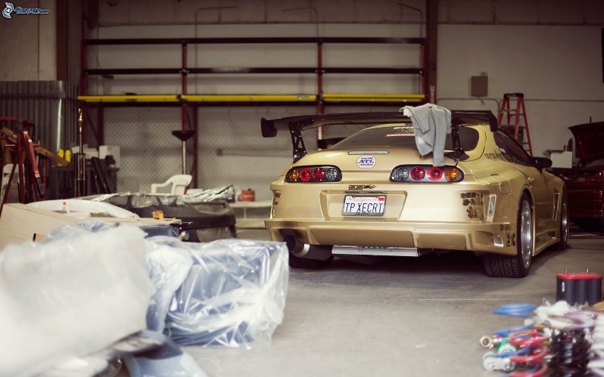
BACK

